Slide 1
BACK TO SCHOOL NIGHT!
WELCOME TO SCIENCE
with MRS. GRASSO

Slide 2
Mrs. Grasso
Contact Information
EMAIL: bgrasso@barnegatschools.com
Phone EXT: 41201
Google Classroom or Teacher Website
*Please make sure to take and fill out a parent homework if you did not already*
Thank you!

Slide 3
Grading in SCIENCE
50% Major Assessments
30% Minor Assessments
15% Course Participation
5% Benchmarks

Slide 4
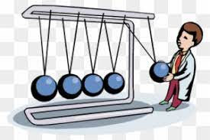
7th Grade
SCIENCE
3 Major Units
Diversity of Living Things
Ecology and the Environment
Motion, Forces and Energy

Slide 5
Thanks for coming!
If your child is feeling overwhelmed in any way, please urge them to communicate with me so I can help. Communication is key and will be very helpful as we navigate this year. I am always an email away, as it is the best way to communicate with me. I am looking forward to a great year together and am so excited to be your child’s teacher. Let’s work together for an awesome year!
I am looking forward to a great year!

